Slide 1
General troubleshooting guidelines

Slide 2
“hAvE yOu TRiEd tUrNiNg iT oFf aNd On aGaiN ????”
-probably some IT dude

Slide 3
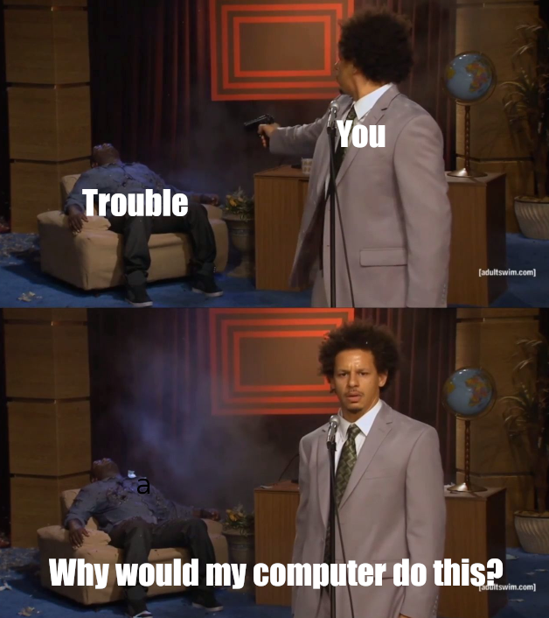
Definition
Tracing and correcting faults within a system

Slide 4

Troubleshooting steps
Fault isolation
Resolve/escalate
Verification

Slide 5
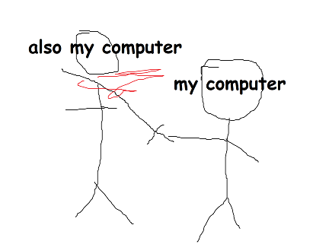
1.
Fault isolation
Try to figure out the root cause of the problem

Slide 6
Wow more steps? AMAAAZING
Define the problem
Gather information
Consider probable cause for the failure

Slide 7

Defining the problem
Be specific!
Vague: my computer is broken
Specific: I am unable to access the internet through my browser
More specific → narrow the problem down more quickly

Slide 8
Pro tip!
Every detail matters. If something feels or looks intuitively wrong, maybe try looking into it - Rahil Shah 2019

Slide 9

Gather information
Troubleshooting applies to specific systems
Therefore you must be knowledgeable about the systems if you want to fix them
Rely on info you already know. Anything else is google-able
Notes:
keep going w the example of not being able to connect to the internet
ex: i know that in order to have wifi access, my NIC card must be function, I need the correct IPs, my DNS server must be working, etc
If I didn’t know about the prerequisite steps that are required before connecting to the internet, I should be looking those up. Or I could just directly look for common errors and troubleshoot those directly

Slide 10

Consider probable cause for the failure
Check for common errors
If that doesn’t work, look through each different part of a system and verify functionality
Notes:
Ex: I know that for internet access, DNS errors can be a common issue. Therefore, I’ll check that first. Most errors you encounter have probably been well documented and solved by someone b4 you.
If that doesn’t work, I can start smaller. For example, if I wanted to check NIC functionality, I could go to device management in windows

Slide 11
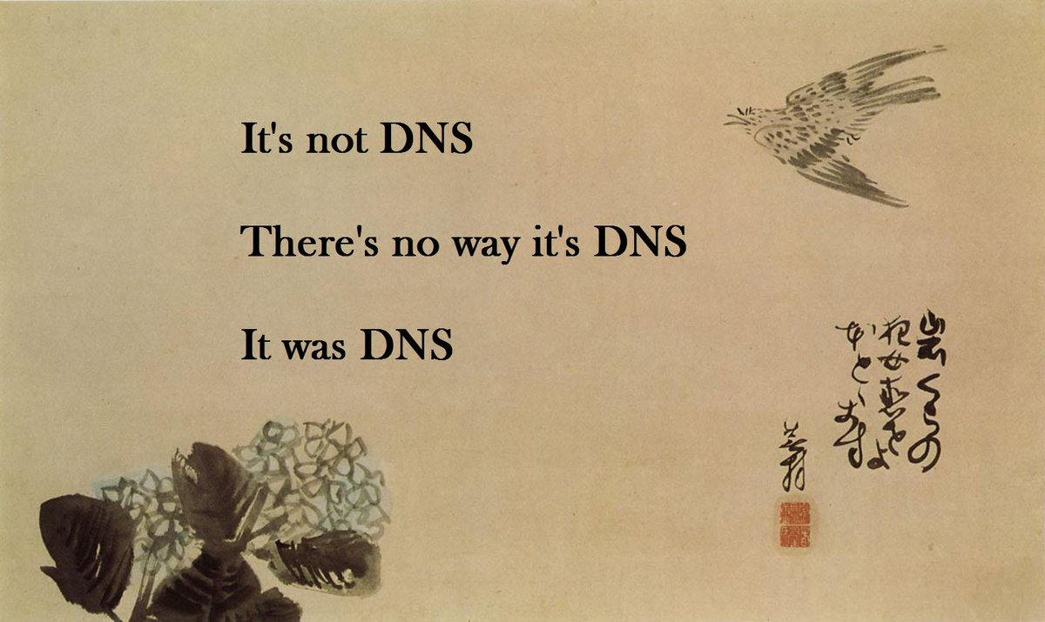

Slide 12
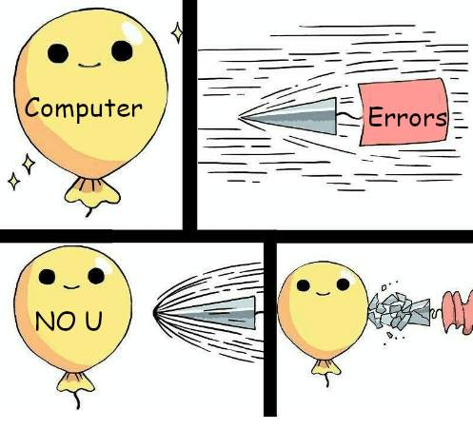
2.
Resolve/escalate

Slide 13
More stepsssss
Devise a plan to solve the problem
Potential escalation
Implement the plan

Slide 14

Devising a plan
Figure out the best way to tackle the probable cause
Someone before you has probably resolved the problem in a forum
Check sites like stackexchange
Notes:
A good idea is to always try restarting the broken service/process

Slide 15

Escalation
If you still can’t figure out a way to solve your problem, it’s time to escalate
In IT, this would mean talking with a higher-up
For cypat, you can’t, so the next best choice is talking it over with your teammates

Slide 16

Implement the plan
Plan has already been figured out
Just do it

Slide 17

3.
Verification
NEVER SKIP THESE!

Slide 18
The last set of steps I swear
Observe the results of the implementation
Test a new hypothesis
Document your results

Slide 19

Observe your results
Test out the new changes
Ex: after establishing DNS connection, try searching for “gmail.com”
Cypat: after configuring the server, ALWAYS check that it remains functional

Slide 20

Test a new hypothesis
If you check the results and you still have problems, then it’s back to the drawing board!

Slide 21

Document your results
For future reference, it’s always good to write down any interesting problems
Ex: logging the forensics questions during cypat is always interesting

Slide 22
Tips and Tricks™
If you have a backup, use it!
Sometimes a system issue is just a faulty service. Make sure your services haven’t been tampered.
Make sure the settings you set yourself aren’t causing the issue either!

Slide 23
More Tips and Tricks™
Sometimes you may get an error when something happens. It may have useful information to solving it!
Don’t forget that Google is your best friend!
You can Google error codes, words on an error page, etc.

Slide 24
THANKS!
Any questions?

